Slide 1

Vaccine System
Bugbusters
Hao Jin
Shanzizhi Shang
Shaocong Tang

Slide 2
System Purpose
This Vaccine System is aimed to build a vaccine inventory management and distribute system that will streamline the workflow of vaccine management including managing inventory of vaccines and administering the vaccines and operate at the national, state and local level in order to improve the efficiency and accountability.

Slide 3
Issue Solved
Safety. Providers can not purchase vaccines if it does not register with local regulators
Efficiency. Doctors can request vaccine directly with the vaccine manger from a health department at the same organization. Health departments can purchase vaccine from a manufacturer directly, specifically from the warehouse organization under a manufacturer.
Convenience. Each role can will have work request records after processing requests. System administration can track all the work requests and manage all the user accounts.
Single Responsibility. The system is designed for vaccine management and transportation specifically. In this case, each organization will have only one ROLE and those roles are all concerned with vaccine.
We will talk about the details when presenting out application.

Slide 4
Entities
Assume that this workflow starts in a single network(state). There are three enterprises including Manufacturer, Regulator, Provider in a network and there are 5 organizations in total.
Manufacturer: Factory Organization and Warehouse Organization.
Regulator: DoPH Organization(Department of Public Health).
Provider: Health Department Organization and Doctor Organization.
There is only one ROLE in each Organization.
Factory Organization: Factory Manager ROLE.
Warehouse Organization: Warehouse Keeper ROLE.
DoPH Organization: Assistant Secretary ROLE.
Health Department Organization: Vaccine Manager ROLE.
Doctor Organization: Doctor ROLE.

Slide 5
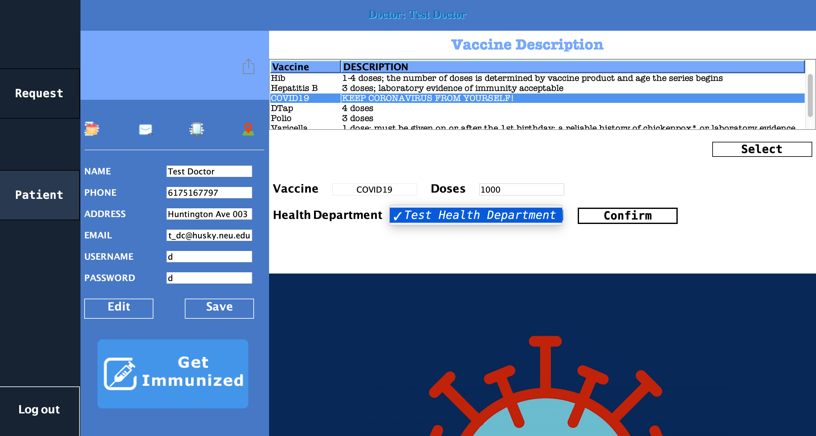
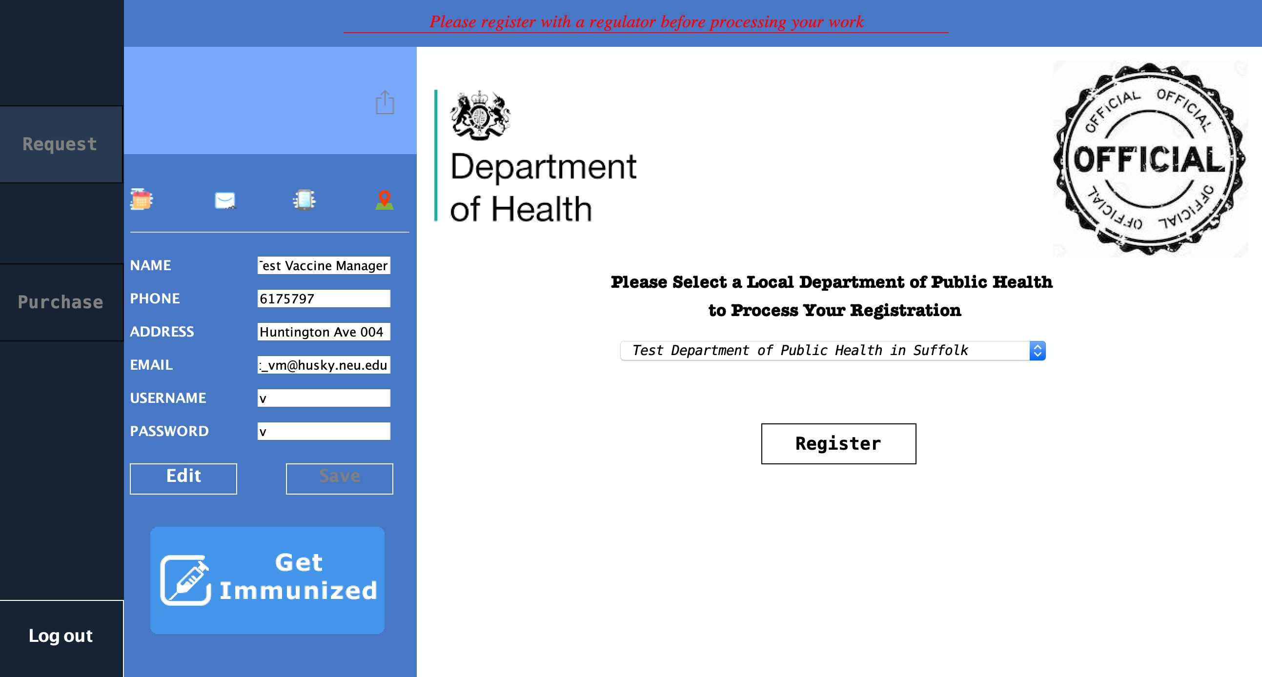
Workflow
Doctor requests the vaccine for a patient
Vaccine Manager need to register under Health Department before approve Doctor’s request

Slide 6
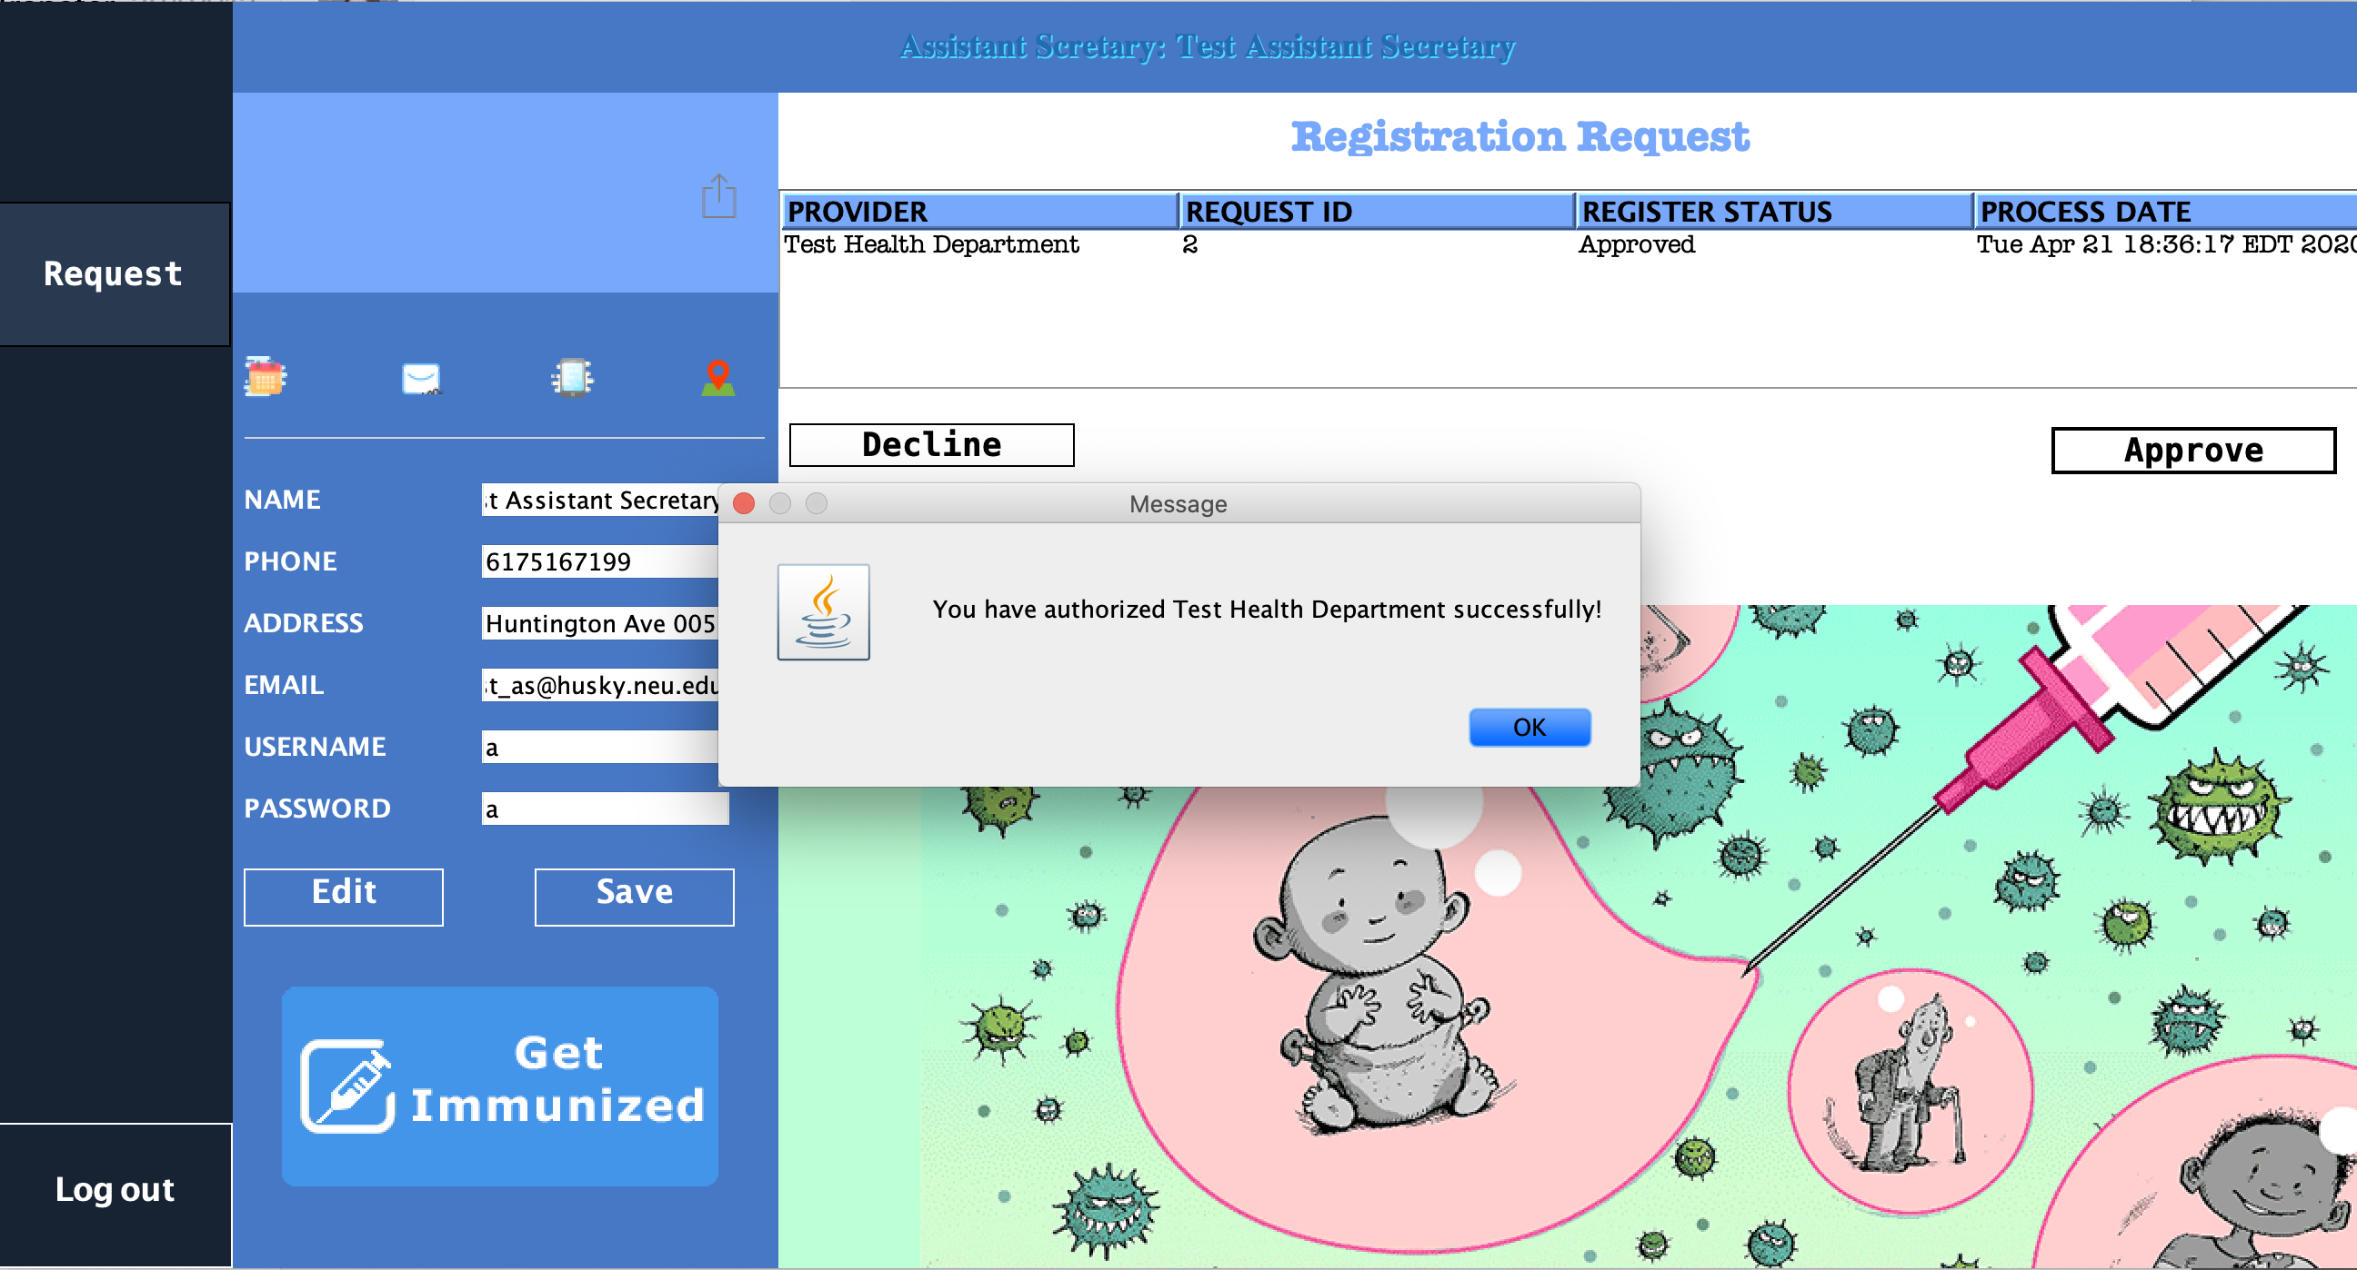
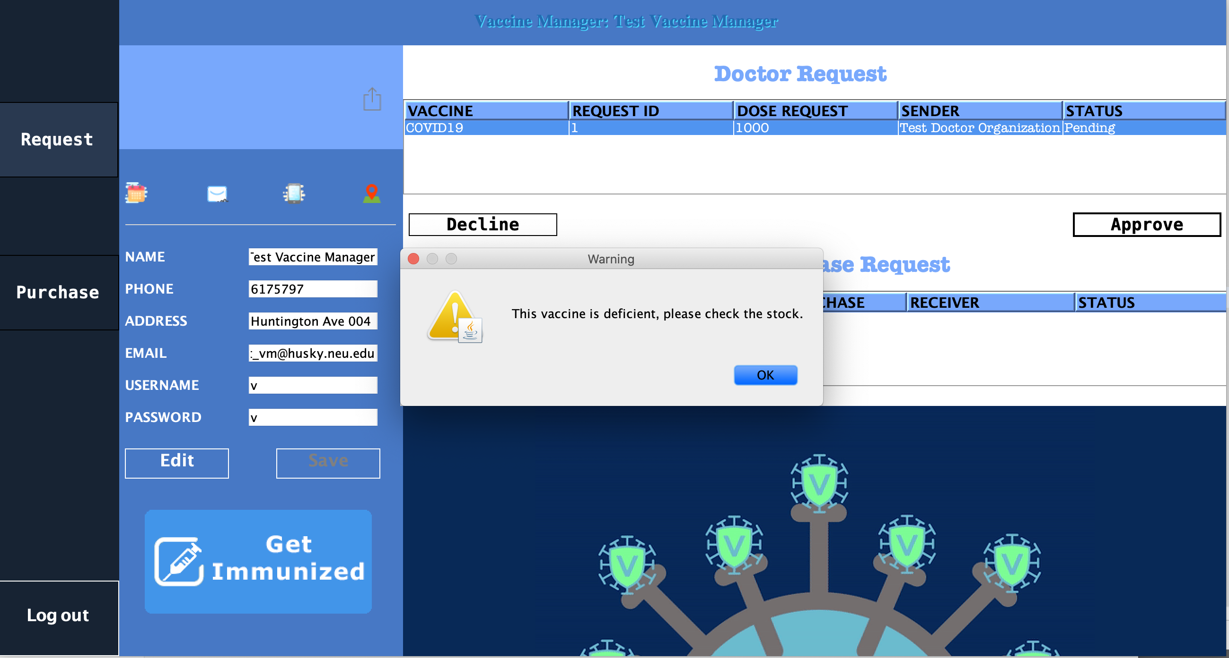
Workflow
Assistant Secretary of the Health Department approves Vaccine Manager’s registration
Vaccine Manager needs to approve Doctor’s request, but this vaccine is currently out of stock

Slide 7
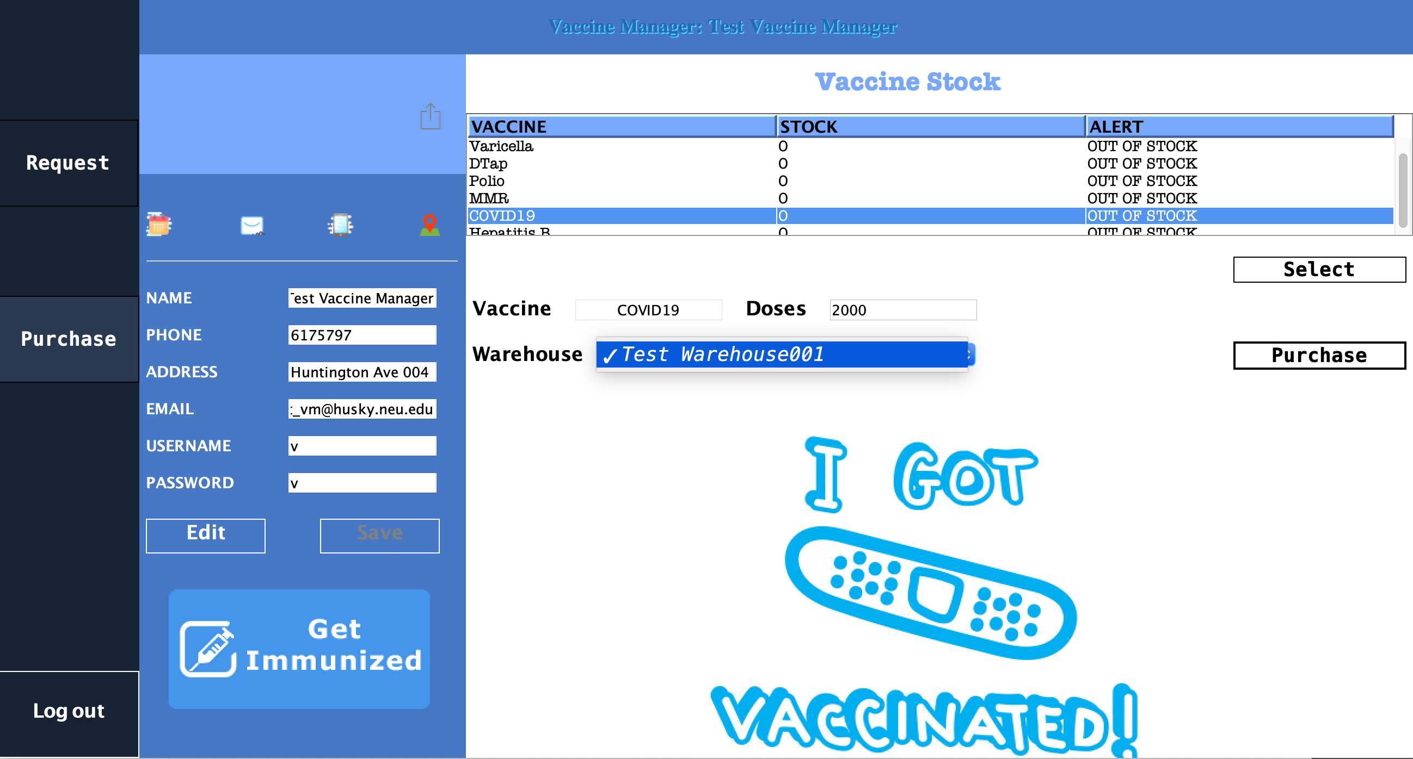
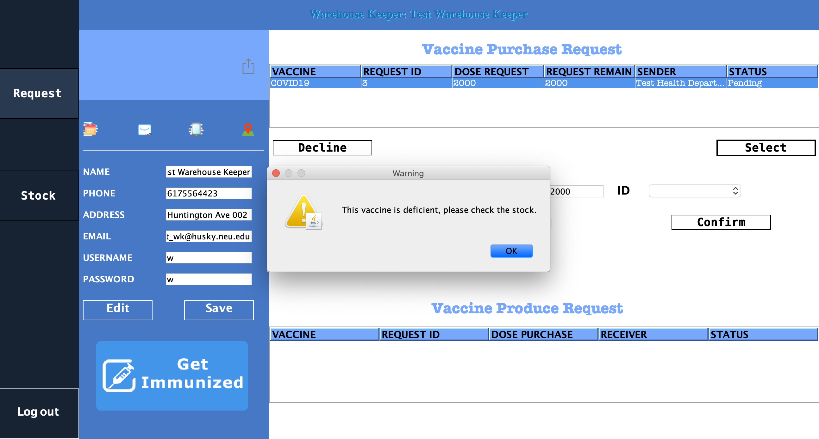
Workflow
Then, Vaccine Manager requests the vaccine purchase with the Warehouse Keeper
This vaccine is currently out of stock, and Warehouse Keeper needs to request production with Factory Manager

Slide 8
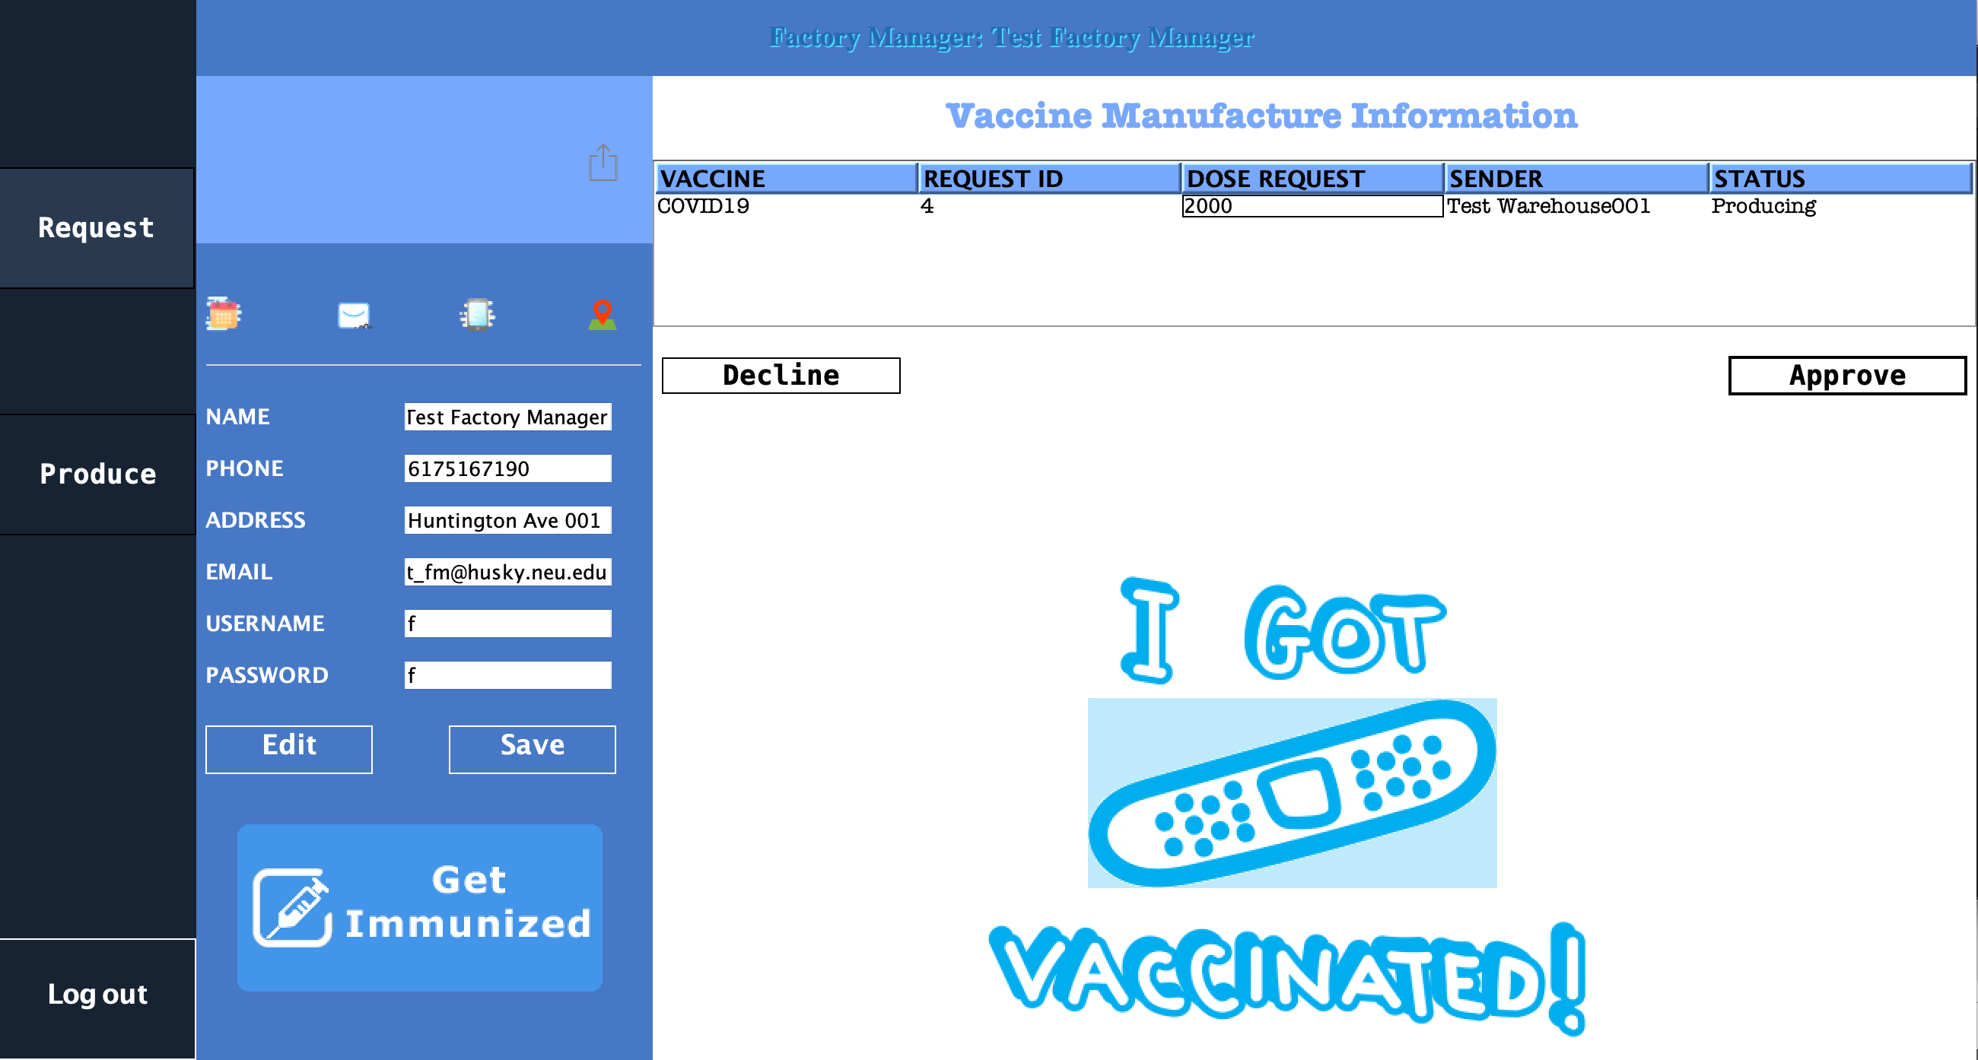
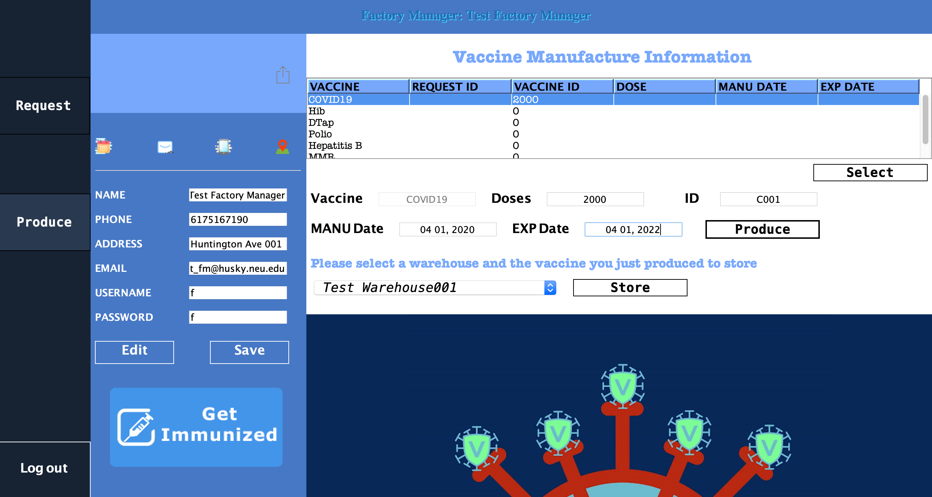
Workflow
Factory Manager approves the vaccine production request from Warehouse Keeper
Factory Manager produces the vaccine

Slide 9
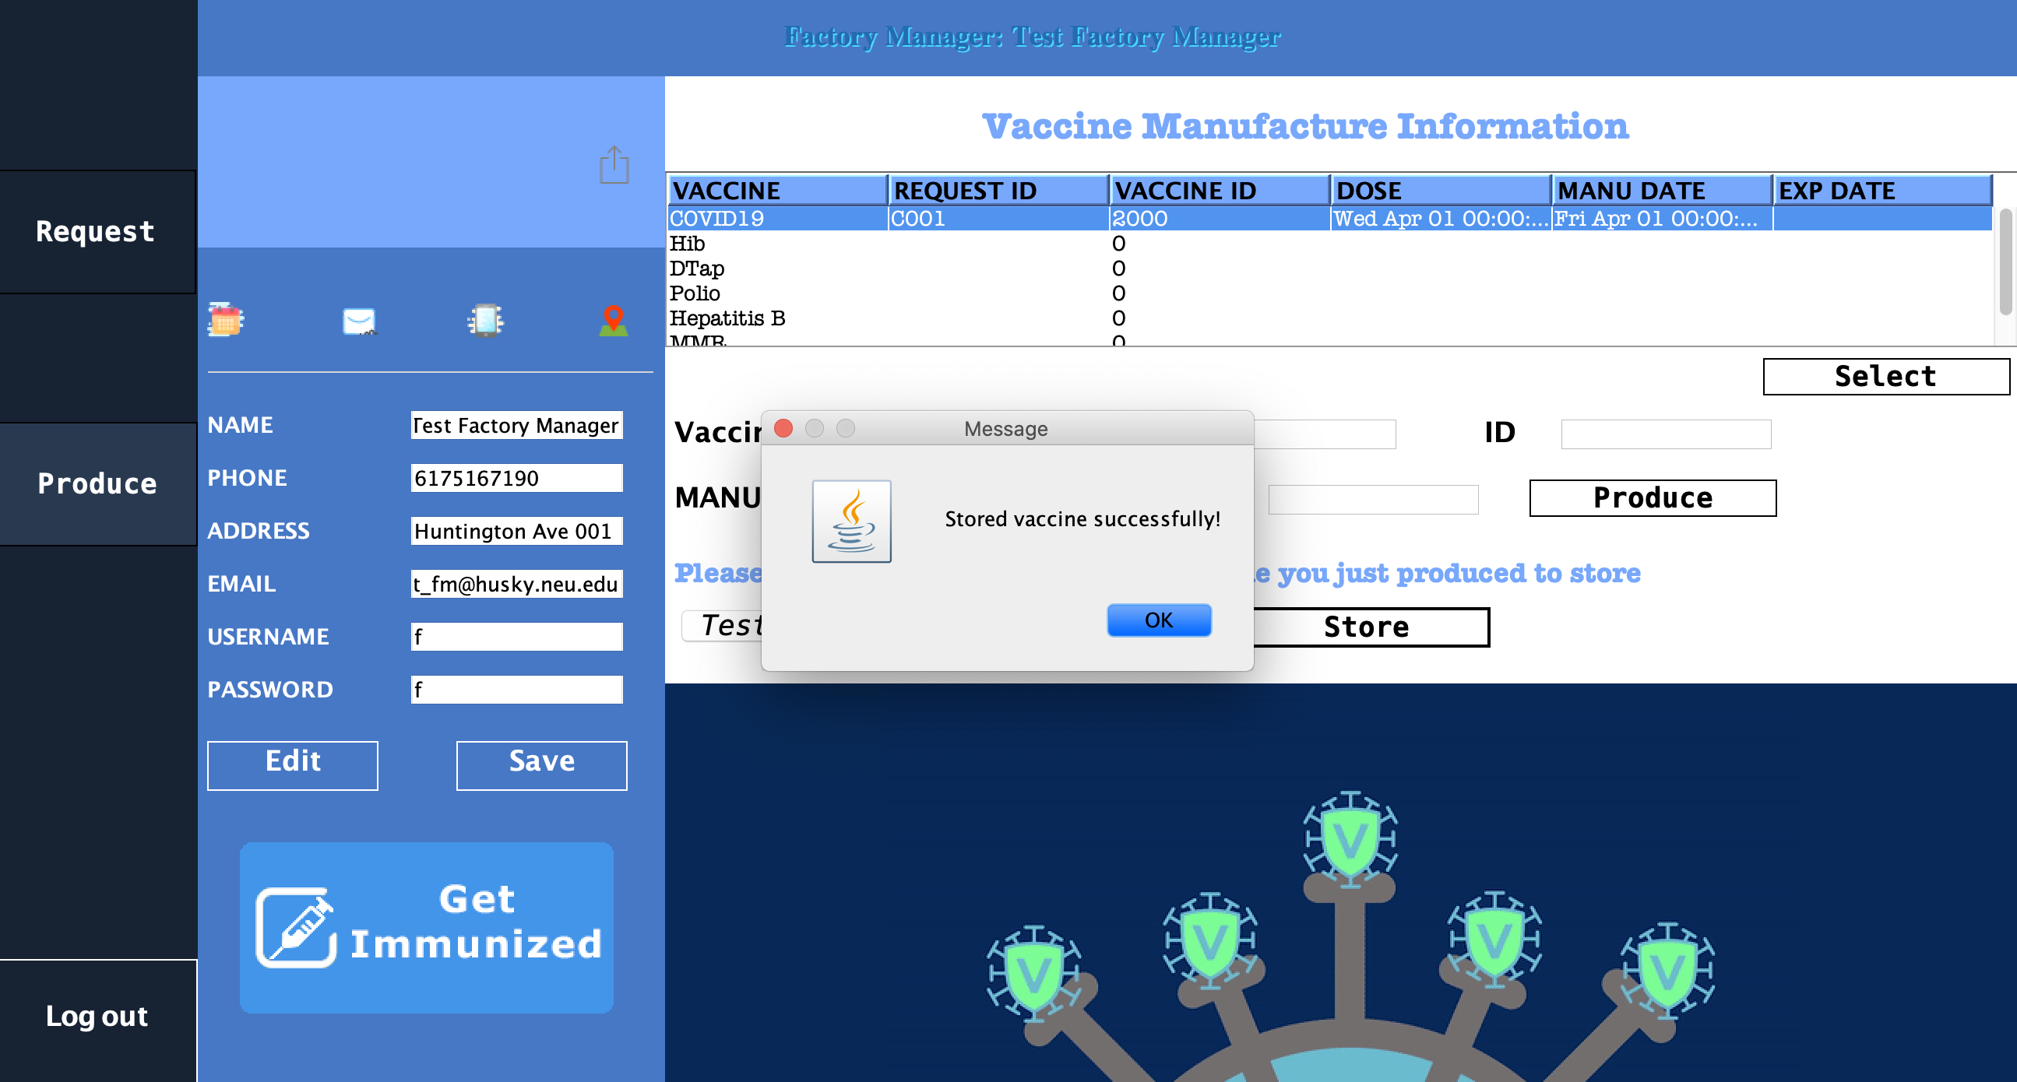
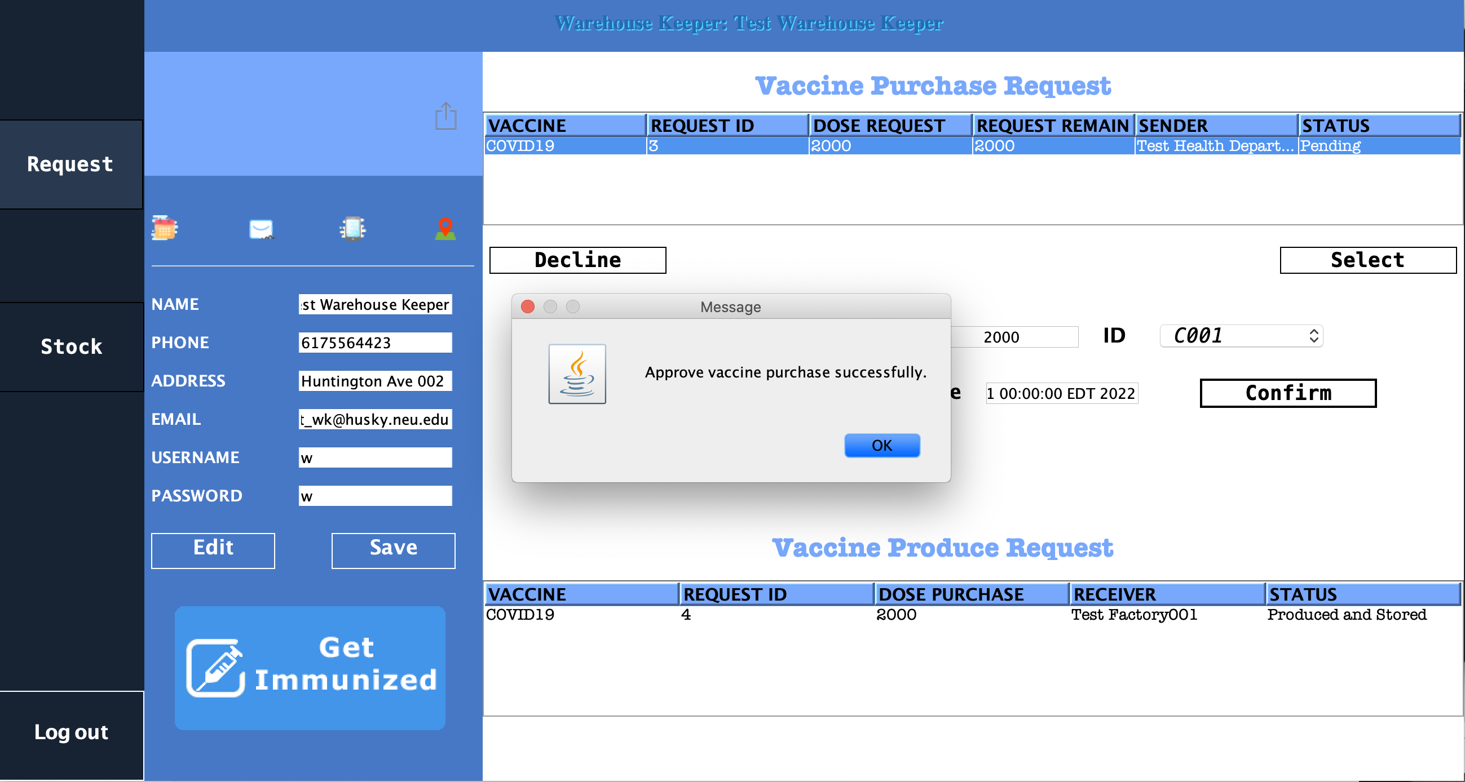
Workflow
Factory Manager stores the vaccine after the production
Warehouse approves the purchase from Vaccine Manager after it’s back in stock, and so will vaccine manager approve the request from doctor.

Slide 10
Roles and Capability
Doctor: request vaccines for patients
Assistants Secretary: approve Health Department registrations
Vaccine Manager: approve vaccine requests from Doctors and request vaccines purchases
Warehouse Keeper: approve vaccine purchases and request vaccine productions
Factory Manager: approve vaccine productions, produce and store vaccines
System Admin: create user accounts, manage all user accounts, manage networks, manage enterprises, manage organizations, track all work requests

Slide 11

Thank You

